Slide 1
Reactive Ordering
trend monitoring
Robert Blacklidge | Springboard | August 1, 2016

Slide 2

Customer Sales

Slide 3





The Datasets

Slide 4

Data Wrangling

Slide 5

Finding the answers

Slide 6
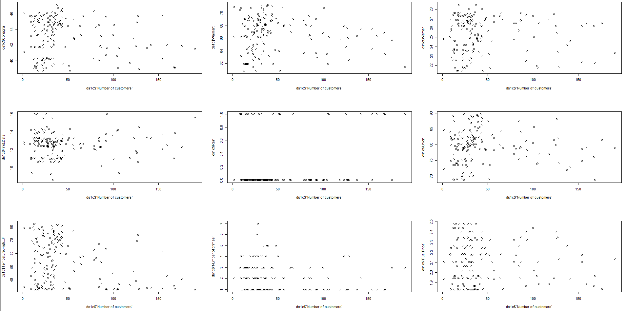
Plotting the data

Slide 7
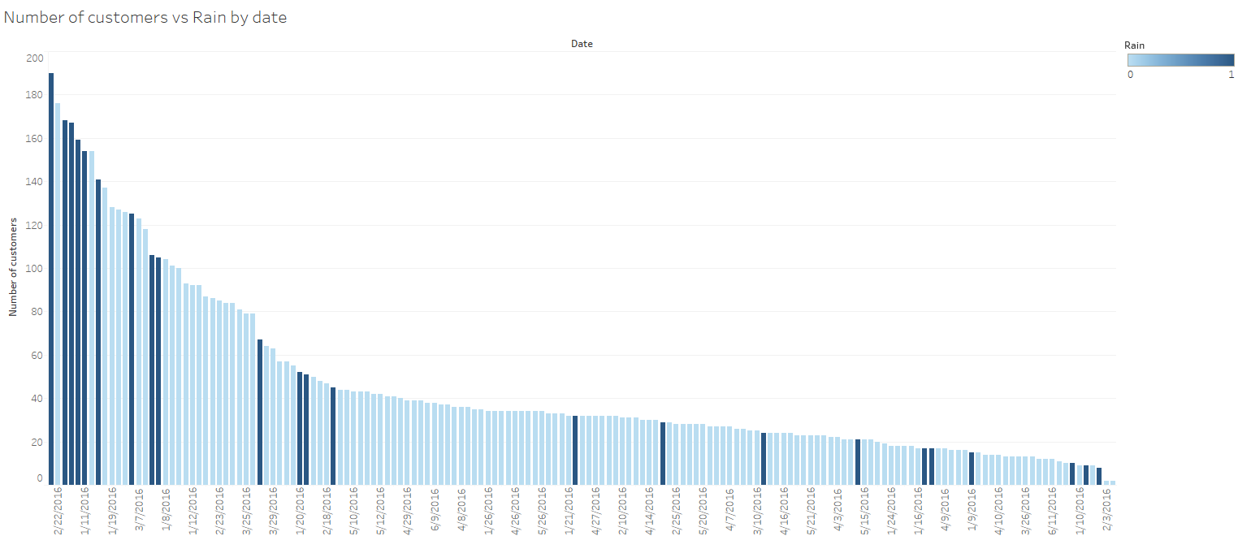
Recommendations

